Slide 1
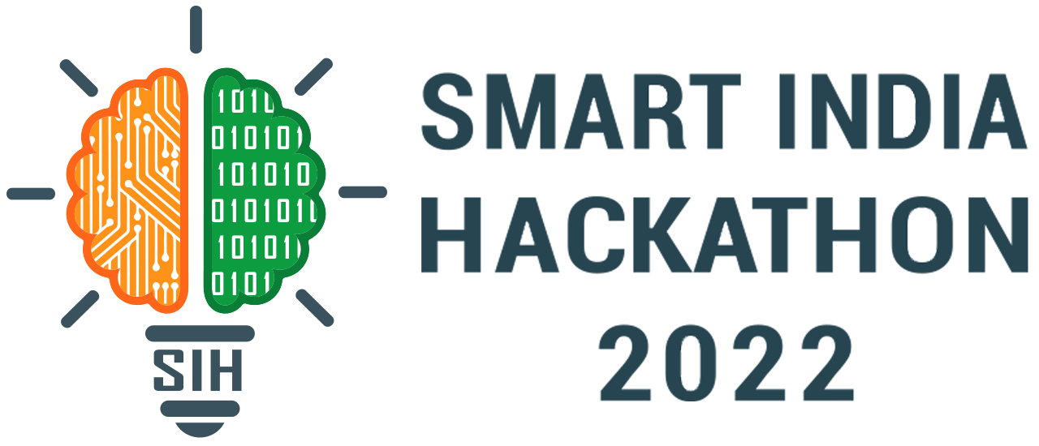
Basic Details of the Team and Problem Statement
Ministry/Organization Name/Student Innovation:
PS Code: SIH1300
Problem Statement Title: Automated Public Lighting
Team Name: Lumina Elite
Team Leader Name: Balaji S
Institute Code (AISHE):
Institute Name: Velammal College of Engineering and Technology, Madurai
Theme Name: Smart Automation

Slide 2
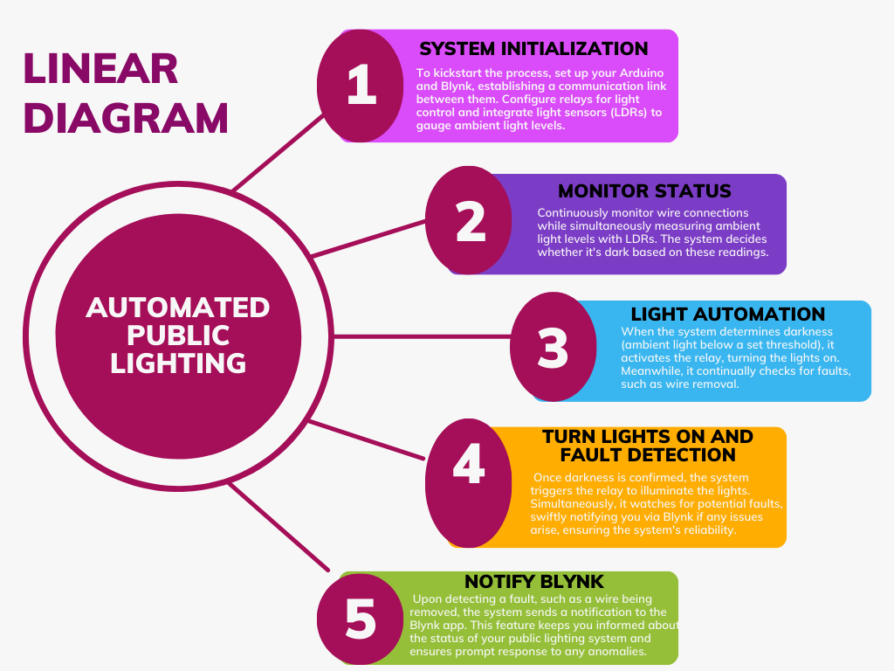
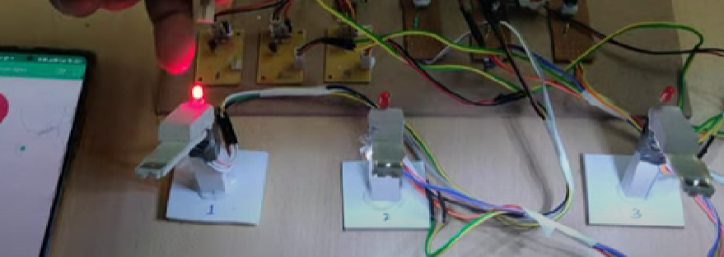
Idea/Approach Details
Describe your idea/Solution/Prototype here:
Efficient Energy Use: Our Automated Public Lighting system optimizes energy consumption by automatically adjusting illumination levels, reducing energy waste.
IoT Central Control: The system is centrally controlled through the Internet of Things (IoT), allowing for remote management and monitoring of public lighting.
Day-Night Sensing: It features day-night sensing technology, ensuring lights are only active when required, even in limited urban spaces. Cost Savings: Reduced energy consumption leads to substantial cost savings for cities.
Quick Fault Detection: Real-time monitoring and fault detection capabilities ensure rapid identification and repair of malfunctioning lights.
Enhanced Safety: Our system improves public safety by ensuring well-lit streets and public areas, contributing to a secure urban environment.
Record of consumption: The amount of energy consumed per lamp is recorded in the database.
Describe your Technology stack here:
Arduino Microcontroller: The core of our system, Arduino, is used for real-time monitoring and control of lighting.
Blynk IoT Platform: Blynk serves as our IoT (Internet of Things) platform, to notify the light with fault.
Light Dependent Resistors (LDRs): LDRs are integrated into our setup as light sensors. These sensors help detect ambient light levels, allowing the system to make informed decisions about when to activate the lights.
Relays: Relays are essential for controlling the electrical circuits of the public lights. They act as switches, allowing the Arduino to turn the lights on or off based on input from sensors and user commands.
Current Sensors and solar batteries: Used to measure how much current it consumes per lamp. The energy generated by the solar panel is stored in these batteries for later use.

Slide 3
Idea/Approach Details
Describe your Use Cases here
Describe your Dependencies / Show stopper here
Energy-Efficient Street Lighting: The system optimizes energy consumption by automatically adjusting lighting levels, ensuring efficient use of electricity and reducing operational costs. The brightness of the light is reduced to 20% during wee hours(late night) to save power.
Fault Detection and Maintenance: It continuously monitors the lighting infrastructure for faults, promptly notifying maintenance teams about issues such as wire disconnections or malfunctioning lights, reducing downtime.
Remote Monitoring and Control: Users can remotely monitor and control public lighting through a user-friendly mobile interface, enhancing operational efficiency and responsiveness.
Sustainable Urban Development: The project aligns with sustainability goals by minimizing light pollution and contributing to eco-friendly urban development practices.
Enhanced Public Safety: Improved lighting during nighttime hours enhances public safety for pedestrians, cyclists, and drivers, reducing the risk of accidents and improving overall security.
Solar energy for power generation: Solar panels are installed on the streetlights which capture sunlight during the day to generate electricity.
Electrical Infrastructure Compatibility: The project's success depends on the compatibility of the existing electrical infrastructure with the automation components. Incompatibility could halt the implementation.
Reliability of Hardware Components: The reliability of hardware components, including LDRs and relays, is critical. Component failures or inaccuracies may disrupt the system's performance.
Internet Connectivity: Reliable internet connectivity is essential for remote monitoring and control through the Blynk app. Dependency on internet access could pose challenges during system management.
Power Supply Reliability: The system relies on a stable power supply. Any interruptions or power outages could lead to system downtime.
Regulatory Compliance: Compliance with local regulations and standards governing public lighting and automation is crucial. Non-compliance may halt the project or lead to legal and regulatory issues.

Slide 4
Team Member Details
Team Leader Name: Balaji S
Branch (Btech/Mtech/PhD etc): BE Stream (ECE, CSE etc): CSE Year (I,II,III,IV): IV
Team Member 1 Name: Rohan Karthikeyan S
Branch (Btech/Mtech/PhD etc): BE Stream (ECE, CSE etc): CSE Year (I,II,III,IV): IV
Team Member 2 Name: Sivabala Subramanian G
Branch (Btech/Mtech/PhD etc): BE Stream (ECE, CSE etc): CSE Year (I,II,III,IV): IV
Team Member 3 Name: Madhavan T S
Branch (Btech/Mtech/PhD etc): BE Stream (ECE, CSE etc): CSE Year (I,II,III,IV): IV
Team Member 4 Name: Shreemathi P S
Branch (Btech/Mtech/PhD etc): BE Stream (ECE, CSE etc): CSE Year (I,II,III,IV): III
Team Member 5 Name: Yazhinipriya L
Branch (Btech/Mtech/PhD etc): BE Stream (ECE, CSE etc): CSE Year (I,II,III,IV): III
Team Mentor 1 Name: Dr. R. Vijayalakshmi
Category (Academic/Industry): Expertise (AI/ML/Blockchain etc): Domain Experience (in years):
Team Mentor 2 Name: Type Your Name Here
Category (Academic/Industry): Expertise (AI/ML/Blockchain etc): Domain Experience (in years):

